Slide 1
OA3103: Data Analysis
Simple Linear Regression: Theory

Slide 2

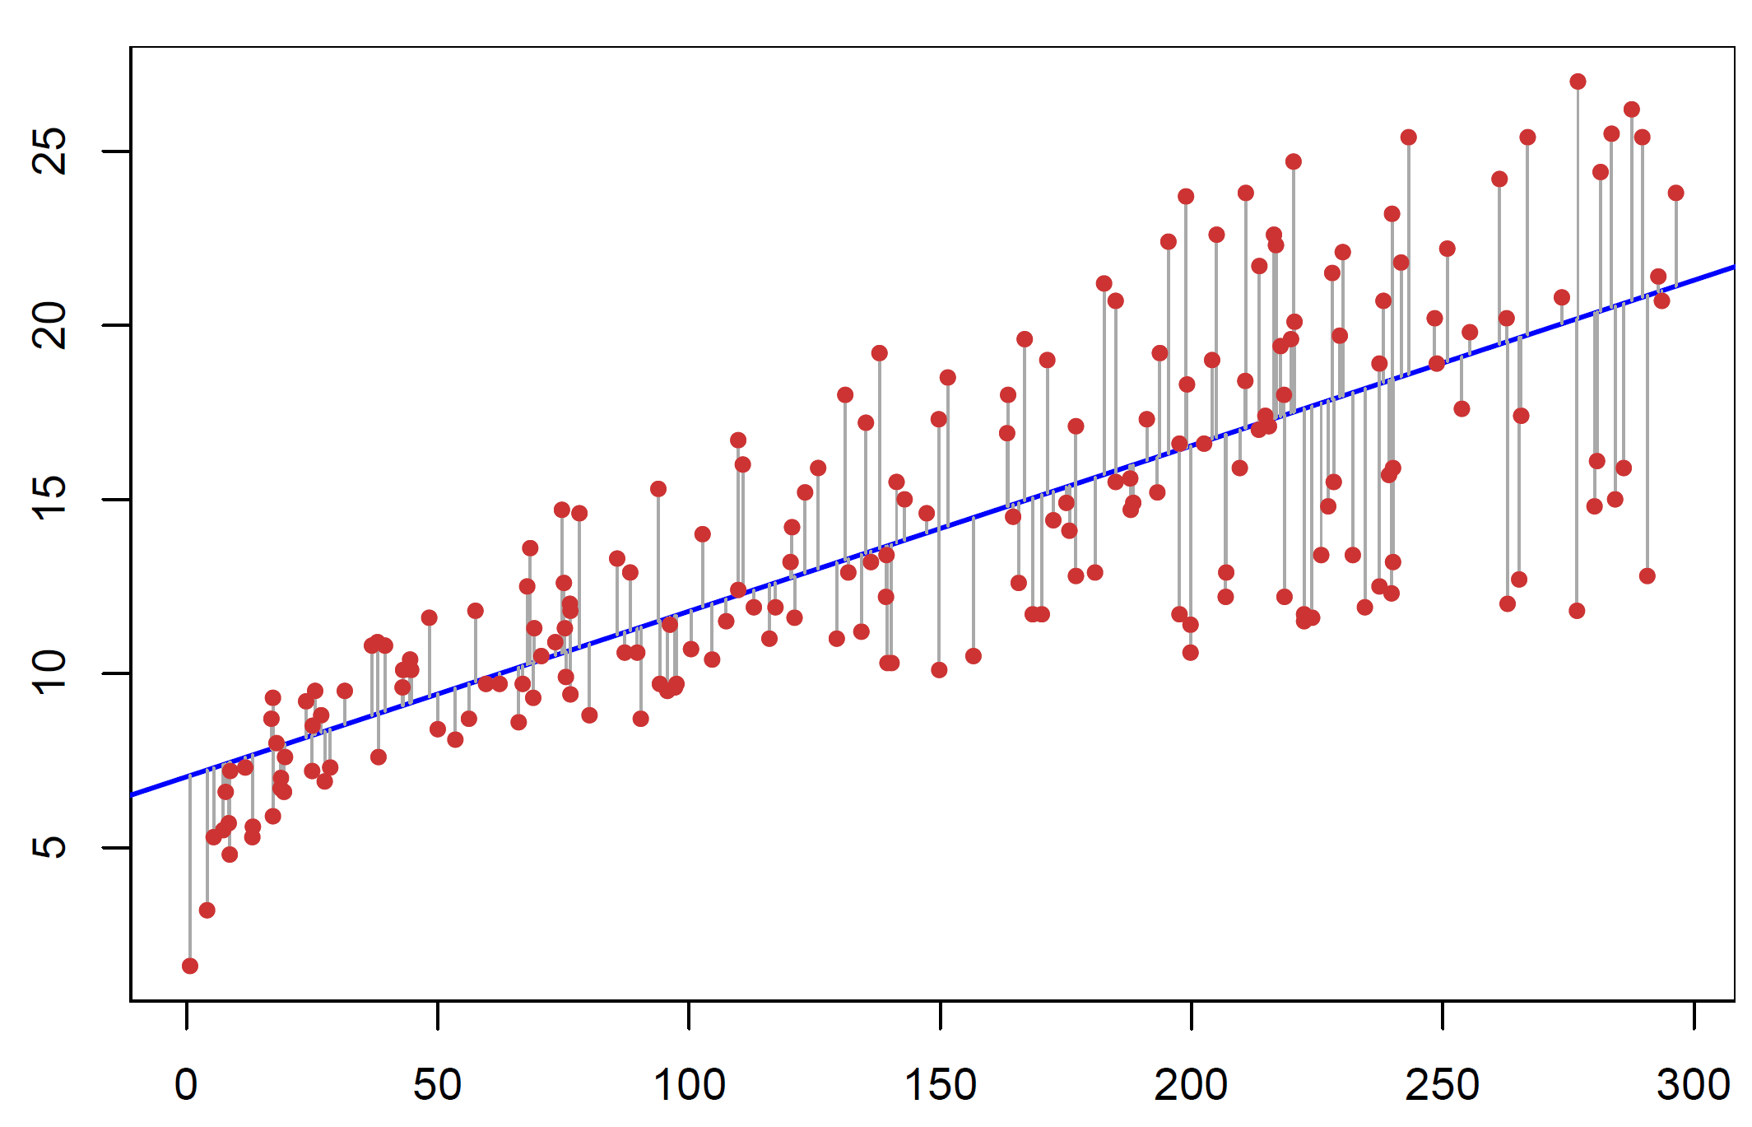
The Big Picture
What is the equation for the “best” line that fits through data comprised of a single input variable for an output/response variable?
Image sources: Simon Sinek How Great Leaders Inspire Action, TED (2009), and ISLP Figure 3.1.

Slide 3
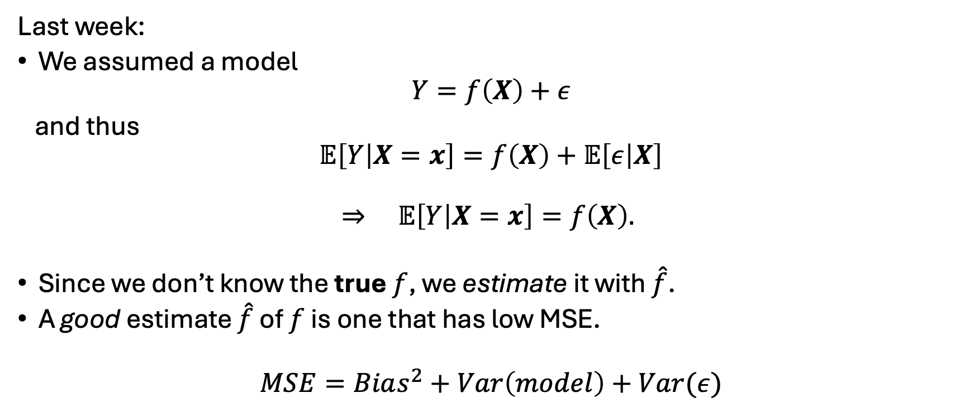
Review and Context
Last week:
We assumed a model
$$Y=f\left(X\right)+ε$$
and thus
$$𝔼\left[Y | X=x\right]=f\left(X\right)+𝔼\left[ε | X\right]$$
$$⇒ 𝔼\left[Y | X=x\right]=f\left(X\right).$$
Since we don’t know the true $f$, we estimate it with $\hat{f}$.
A good estimate $\hat{f}$ of $f$ is one that has low MSE.
$$MSE=Bias^{2}+Var\left(model\right)+Var(ε)$$
Notes:
Think of $X$as the information we can know. Once we condition on $X$, it’s no longer random — it’s fixed.
The only randomness left in $Y$comes from $ε$.
So the conditional expectation $E\left[Y∣X\right]$is just the average value of $Y$over the noise. And because the noise has mean zero, that average is exactly $f\left(X\right)$

Slide 4
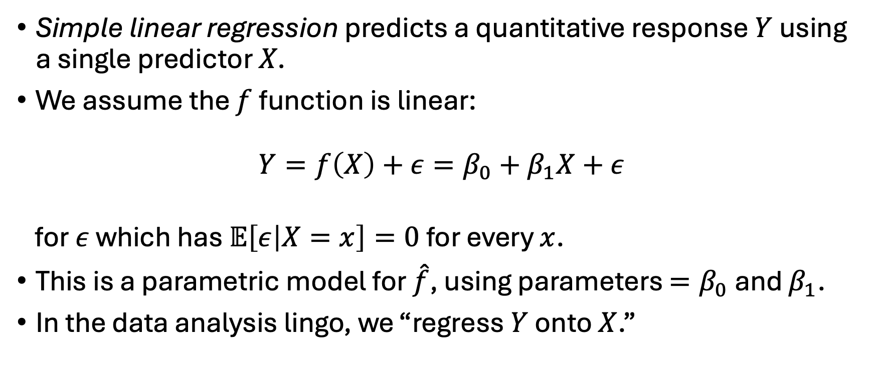
Simple Linear Regression
Simple linear regression predicts a quantitative response $Y$ using a single predictor $X$.
We assume the $f$ function is linear:
$$Y=f\left(X\right)+ε=β_{0}+β_{1}X+ε$$
for $ε$ which has $𝔼\left[ε | X=x\right]=0$ for every $x$.
This is a parametric model for $\hat{f}$, using parameters $=β_{0}$ and $β_{1}$.
In the data analysis lingo, we “regress $Y$ onto $X$.”

Slide 5
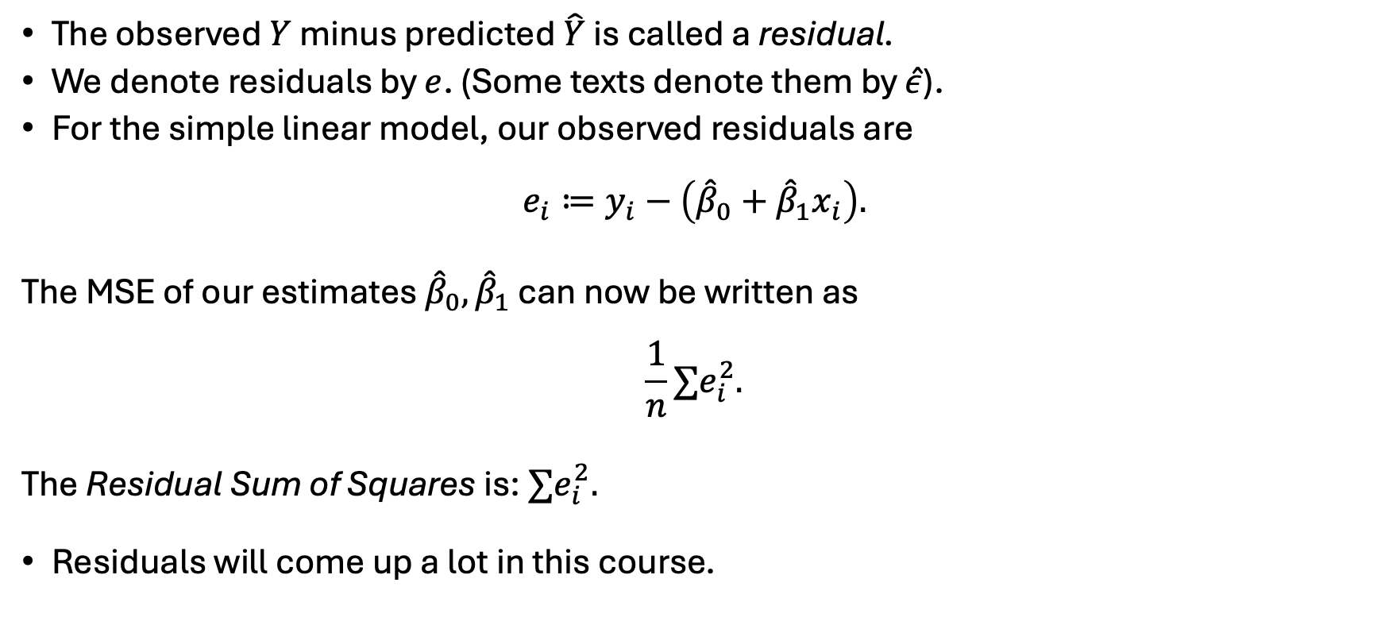
More Data Analysis Lingo
The observed $Y$ minus predicted $\hat{Y}$ is called a residual.
We denote residuals by $e$. (Some texts denote them by $\hat{ε}$).
For the simple linear model, our observed residuals are
$$e_{i}≔y_{i}−\left({\hat{β}}_{0}+{\hat{β}}_{1}x_{i}\right).$$
The MSE of our estimates ${\hat{β}}_{0},{\hat{β}}_{1}$ can now be written as
$$\frac{1}{n}∑e_{i}^{2}.$$
The Residual Sum of Squares is: $∑e_{i}^{2}.$
Residuals will come up a lot in this course.

Slide 6
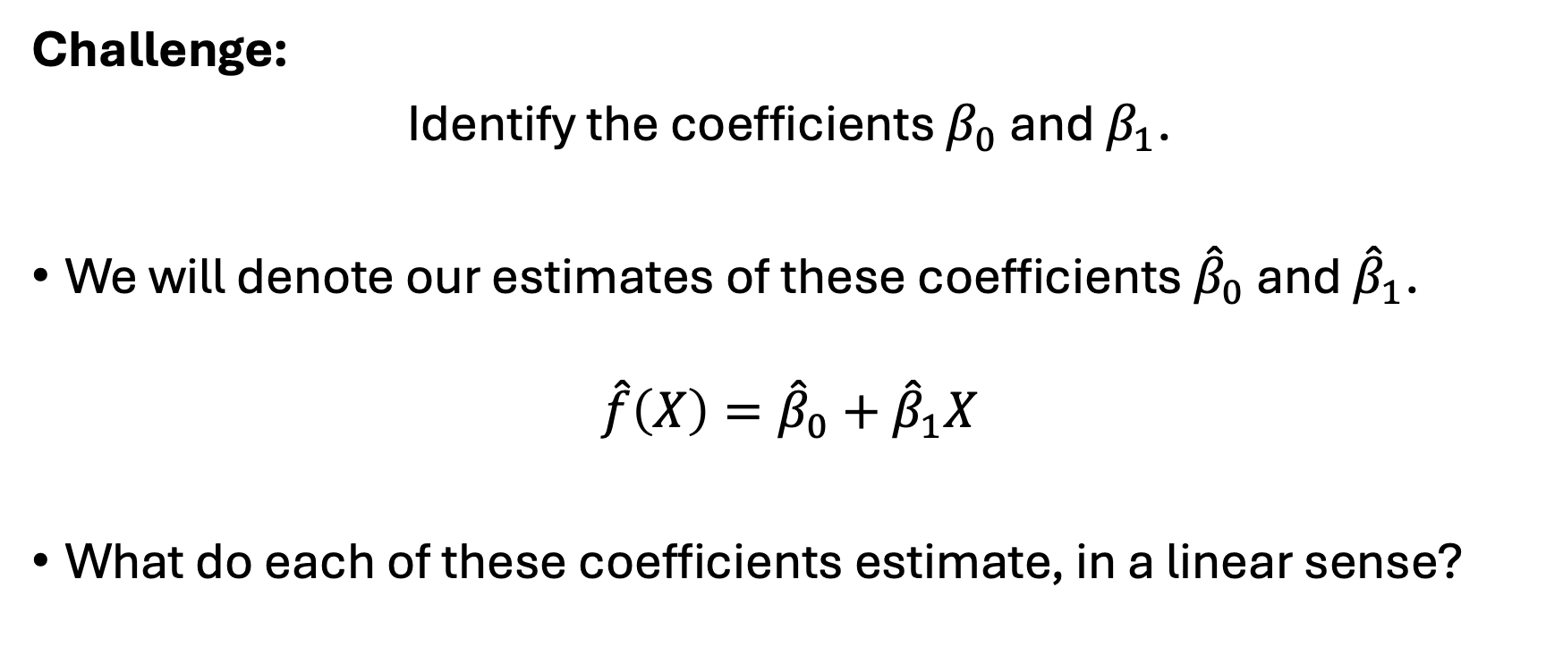
Simple linear regression
Challenge:
Identify the coefficients $β_{0}$ and $β_{1}$.
We will denote our estimates of these coefficients ${\hat{β}}_{0}$ and ${\hat{β}}_{1}$.
$$\hat{f}\left(X\right)={\hat{β}}_{0}+{\hat{β}}_{1}X$$
What do each of these coefficients estimate, in a linear sense?

Slide 7
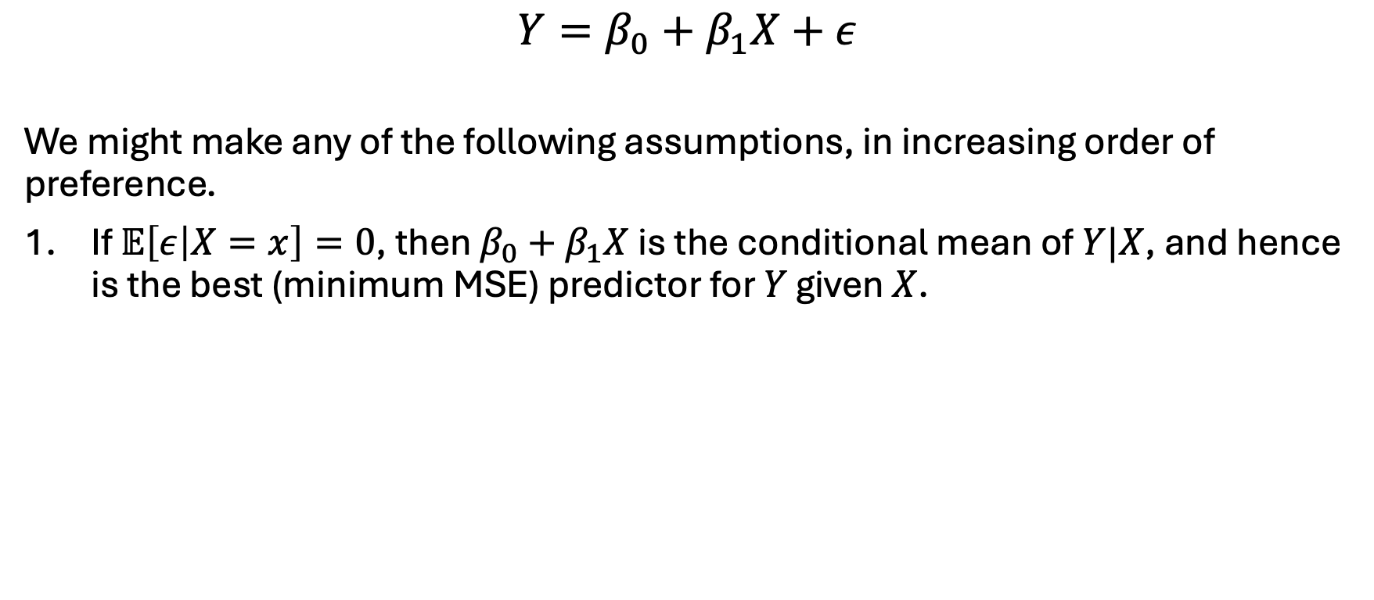
Some Common Assumptions
$$Y=β_{0}+β_{1}X+ε$$
We might make any of the following assumptions, in increasing order of preference.
If $𝔼\left[ε | X=x\right]=0$, then $β_{0}+β_{1}X$ is the conditional mean of $Y|X$, and hence is the best (minimum MSE) predictor for $Y$ given $X$.
Notes:
This is the minimum assumption needed for linear regression to make sense as a predictive tool.
Under this assumption:
$β_{0}+β_{1}X$is the true conditional mean of $Y$.
The regression line is the best possible predictor of $Y$given $X$(in the MSE sense).
OLS estimates are unbiased.

Slide 8
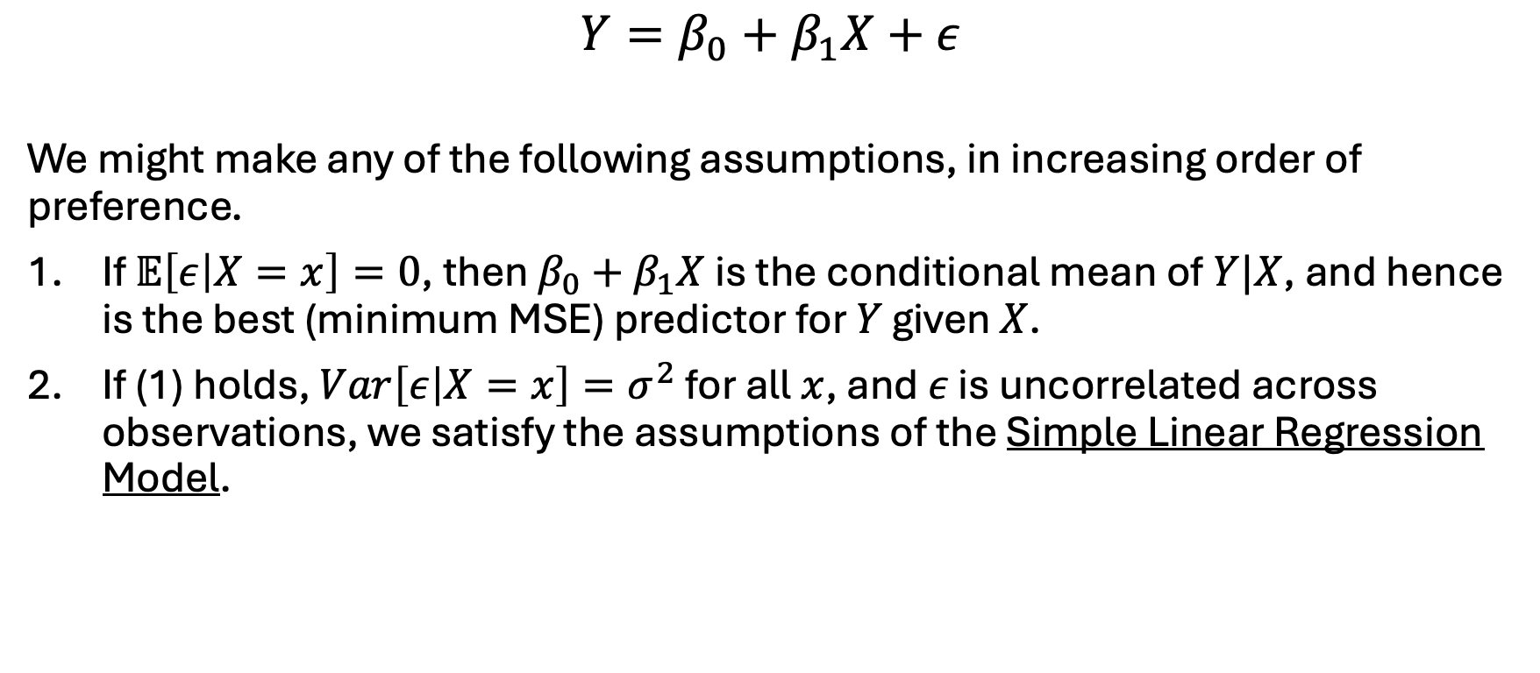
Some Common Assumptions
$$Y=β_{0}+β_{1}X+ε$$
We might make any of the following assumptions, in increasing order of preference.
If $𝔼\left[ε | X=x\right]=0$, then $β_{0}+β_{1}X$ is the conditional mean of $Y|X$, and hence is the best (minimum MSE) predictor for $Y$ given $X$.
If (1) holds, $Var\left[ε | X=x\right]=σ^{2}$ for all $x$, and $ε$ is uncorrelated across observations, we satisfy the assumptions of the Simple Linear Regression Model.
Notes:
Here we have added the structure needed for valid inference in the classical SLR model.
With this assumption:
OLS is still unbiased (from Assumption 1).
OLS is now BLUE (Gauss–Markov). (Best Linear Unbiased Estimator)
We can compute standard errors.
We can construct confidence intervals.
We can run t‑tests and F‑tests.

Slide 9
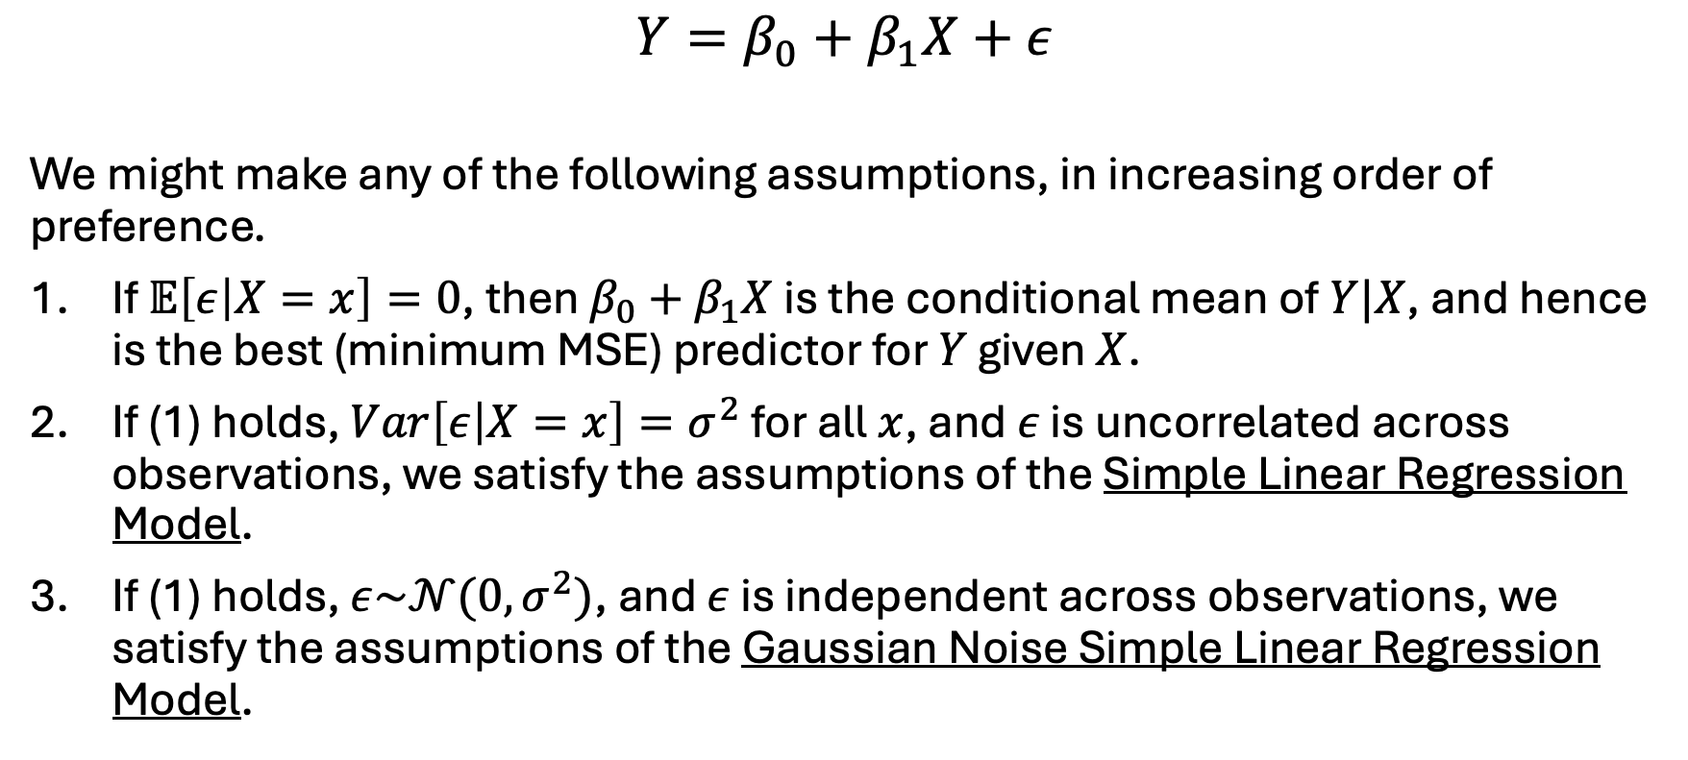
Some Common Assumptions
$$Y=β_{0}+β_{1}X+ε$$
We might make any of the following assumptions, in increasing order of preference.
If $𝔼\left[ε | X=x\right]=0$, then $β_{0}+β_{1}X$ is the conditional mean of $Y|X$, and hence is the best (minimum MSE) predictor for $Y$ given $X$.
If (1) holds, $Var\left[ε | X=x\right]=σ^{2}$ for all $x$, and $ε$ is uncorrelated across observations, we satisfy the assumptions of the Simple Linear Regression Model.
If (1) holds, $ε\sim 𝒩(0,σ^{2})$, and $ε$ is independent across observations, we satisfy the assumptions of the Gaussian Noise Simple Linear Regression Model.
Notes:
Corr = 0 -> independence only if Normal RVs.
Normality gives us exact finite-sample distributions for:
${\hat{β}}_{0},{\hat{β}}_{1}$
t‑statistics
F‑statistics
prediction intervals
Everything becomes exact, not asymptotic.
We can derive exact sampling distributions, use exact t- and F-tests
Construct exact prediction intervals
Use likelihood-based methods

Slide 10
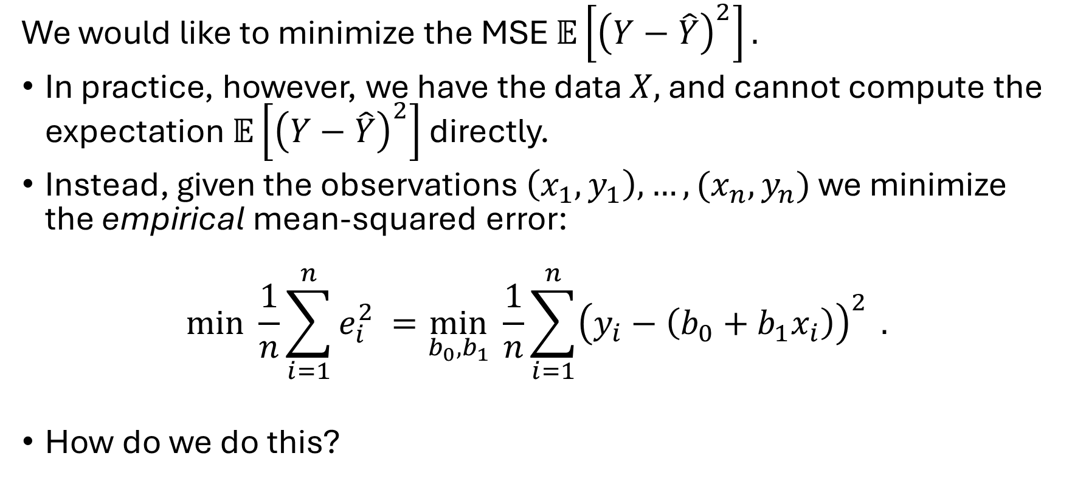
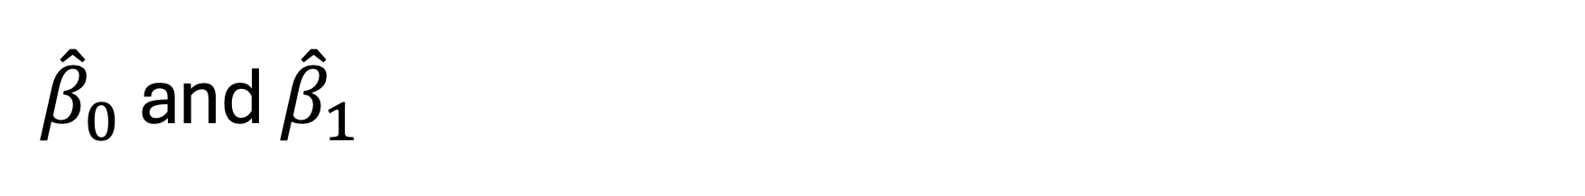
${\hat{β}}_{0}$ and ${\hat{β}}_{1}$
We would like to minimize the MSE $𝔼\left[{\left(Y−\hat{Y}\right)}^{2}\right].$
In practice, however, we have the data $X,$ and cannot compute the expectation $𝔼\left[{\left(Y−\hat{Y}\right)}^{2}\right]$ directly.
Instead, given the observations $\left(x_{1},y_{1}\right),…,(x_{n},y_{n})$ we minimize the empirical mean-squared error:
$$\min_{ }{\frac{1}{n}{\sum_{i=1}^{n}{e_{i}^{2}}}^{ }}=\min_{b_{0},b_{1}}{\frac{1}{n}{\sum_{i=1}^{n}{{\left(y_{i}−\left(b_{0}+b_{1}x_{i}\right)\right)}^{2}}}^{ }.}$$
How do we do this?

Slide 11
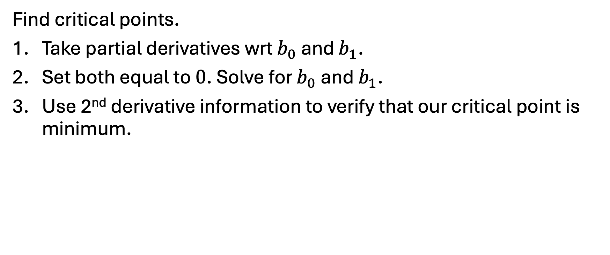
Time for some calculus.
Find critical points.
Take partial derivatives wrt $b_{0}$ and $b_{1}$.
Set both equal to $0$. Solve for $b_{0}$ and $b_{1}$.
Use 2nd derivative information to verify that our critical point is minimum.

Slide 12
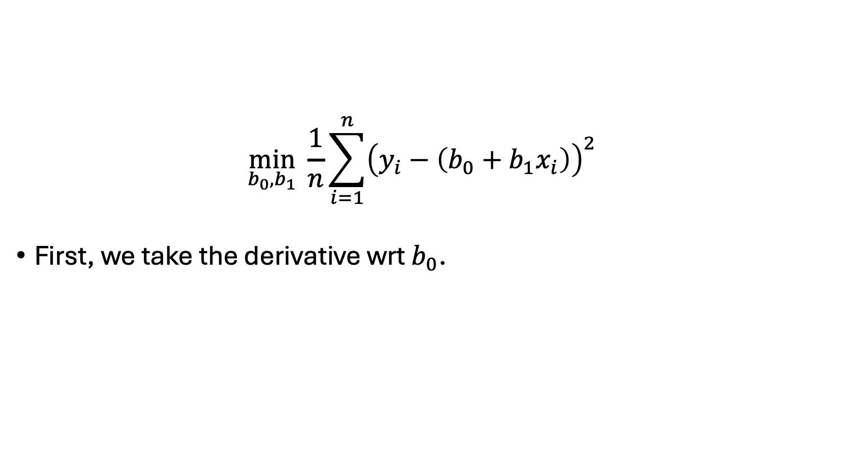
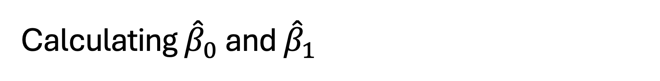
Calculating ${\hat{β}}_{0}$ and ${\hat{β}}_{1}$
$$\min_{b_{0},b_{1}}{\frac{1}{n}{\sum_{i=1}^{n}{{\left(y_{i}−\left(b_{0}+b_{1}x_{i}\right)\right)}^{2}}}^{ }}$$
First, we take the derivative wrt $b_{0}$.

Slide 13
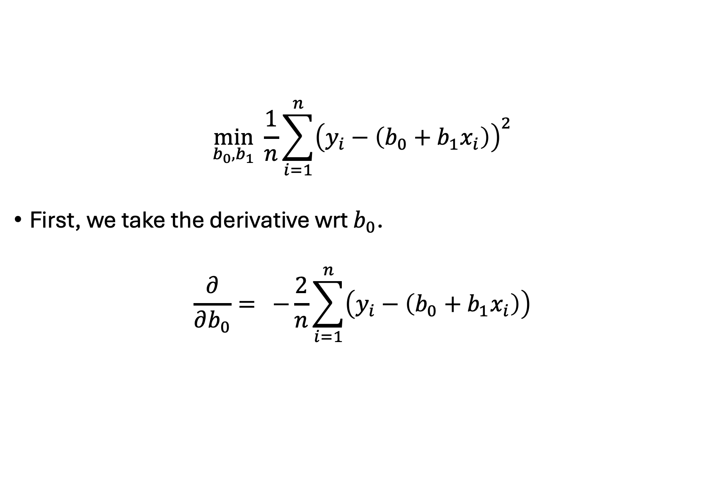
Calculating ${\hat{β}}_{0}$ and ${\hat{β}}_{1}$
$$\min_{b_{0},b_{1}}{\frac{1}{n}{\sum_{i=1}^{n}{{\left(y_{i}−\left(b_{0}+b_{1}x_{i}\right)\right)}^{2}}}^{ }}$$
First, we take the derivative wrt $b_{0}$.
$$\frac{∂}{∂b_{0}}={−\frac{2}{n}{\sum_{i=1}^{n}{\left(y_{i}−\left(b_{0}+b_{1}x_{i}\right)\right)}}^{ }}$$

Slide 14
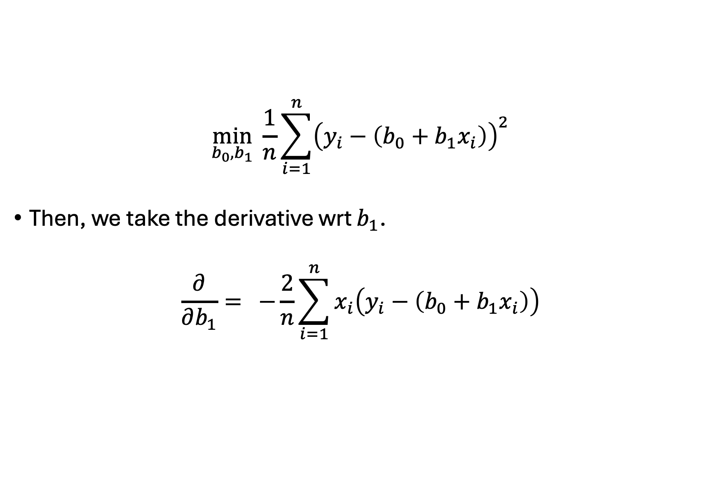
Calculating ${\hat{β}}_{0}$ and ${\hat{β}}_{1}$
$$\min_{b_{0},b_{1}}{\frac{1}{n}{\sum_{i=1}^{n}{{\left(y_{i}−\left(b_{0}+b_{1}x_{i}\right)\right)}^{2}}}^{ }}$$
Then, we take the derivative wrt $b_{1}$.
$$\frac{∂}{∂b_{1}}={−\frac{2}{n}{\sum_{i=1}^{n}{x_{i}\left(y_{i}−\left(b_{0}+b_{1}x_{i}\right)\right)}}^{ }}$$

Slide 15
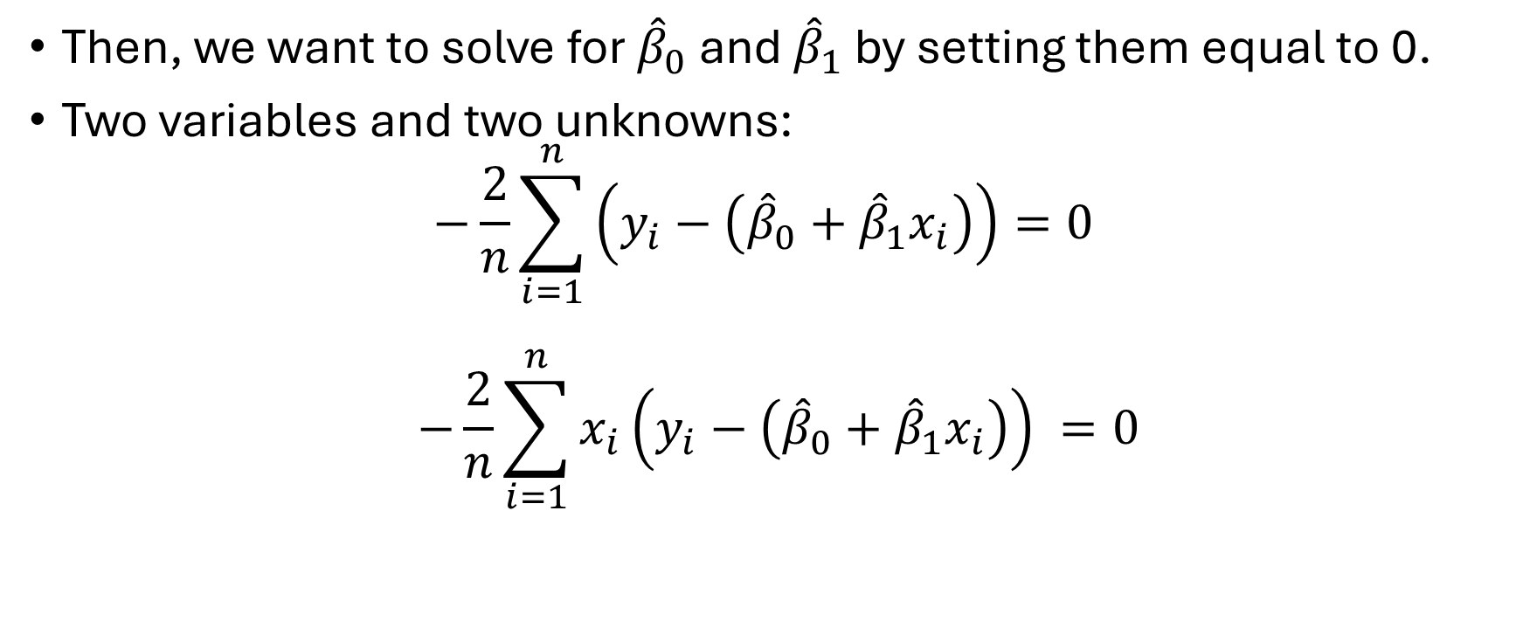
Calculating ${\hat{β}}_{0}$ and ${\hat{β}}_{1}$
Then, we want to solve for ${\hat{β}}_{0}$ and ${\hat{β}}_{1}$ by setting them equal to 0.
Two variables and two unknowns:
$$−\frac{2}{n}{\sum_{i=1}^{n}{\left(y_{i}−\left({\hat{β}}_{0}+{\hat{β}}_{1}x_{i}\right)\right)}=0}^{ }$$
$${−\frac{2}{n}{\sum_{i=1}^{n}{x_{i}\left(y_{i}−\left({\hat{β}}_{0}+{\hat{β}}_{1}x_{i}\right)\right)}}^{ }}=0$$

Slide 16
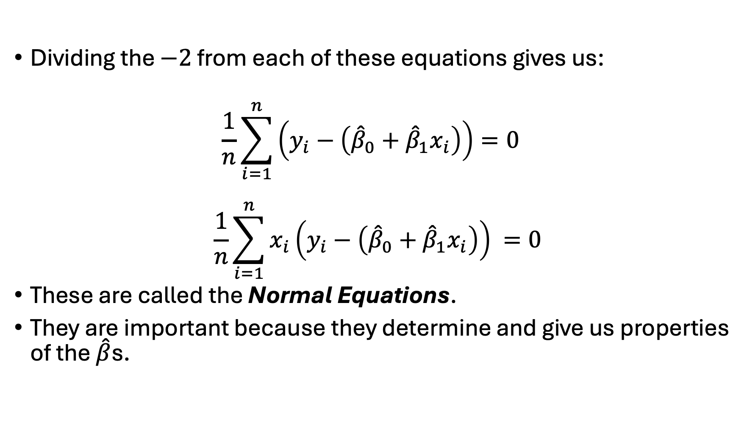
Calculating ${\hat{β}}_{0}$ and ${\hat{β}}_{1}$
Dividing the $−2$ from each of these equations gives us:
$$\frac{1}{n}{\sum_{i=1}^{n}{\left(y_{i}−\left({\hat{β}}_{0}+{\hat{β}}_{1}x_{i}\right)\right)}=0}^{ }$$
$${\frac{1}{n}{\sum_{i=1}^{n}{x_{i}\left(y_{i}−\left({\hat{β}}_{0}+{\hat{β}}_{1}x_{i}\right)\right)}}^{ }}=0$$
These are called the Normal Equations.
They are important because they determine and give us properties of the $\hat{β}$s.

Slide 17
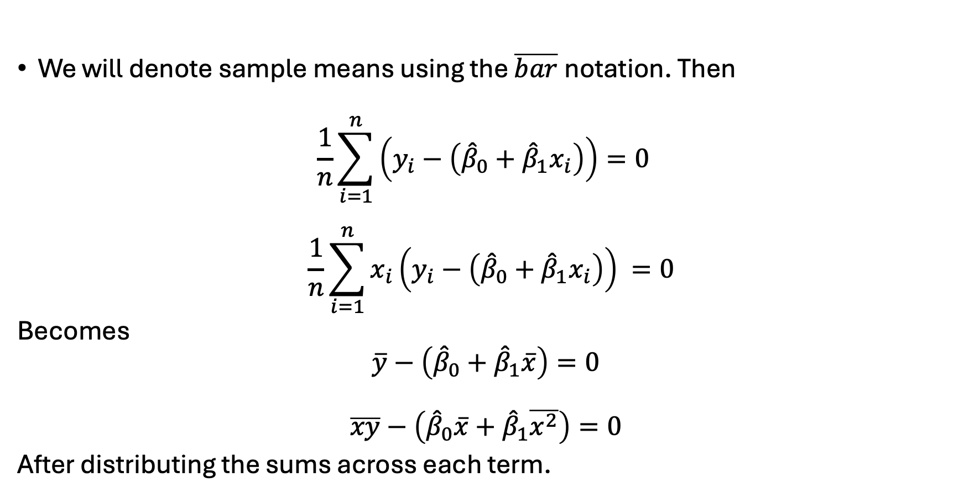
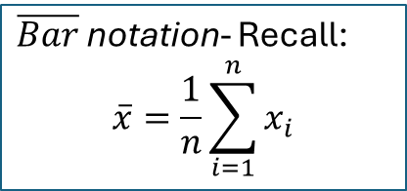
Calculating ${\hat{β}}_{0}$ and ${\hat{β}}_{1}$
We will denote sample means using the $\overline{bar}$notation. Then
$$\frac{1}{n}{\sum_{i=1}^{n}{\left(y_{i}−\left({\hat{β}}_{0}+{\hat{β}}_{1}x_{i}\right)\right)}=0}^{ }$$
$${\frac{1}{n}{\sum_{i=1}^{n}{x_{i}\left(y_{i}−\left({\hat{β}}_{0}+{\hat{β}}_{1}x_{i}\right)\right)}}^{ }}=0$$
Becomes
$$\overline{y}−\left({\hat{β}}_{0}+{\hat{β}}_{1}\overline{x}\right)=0$$
$$\overline{xy}−\left({\hat{β}}_{0}\overline{x}+{\hat{β}}_{1}\overline{x^{2}}\right)=0$$
After distributing the sums across each term.
$\overline{Bar}$ notation- Recall:
$$\overline{x}=\frac{1}{n}\sum_{i=1}^{n}{x_{i}}$$

Slide 18
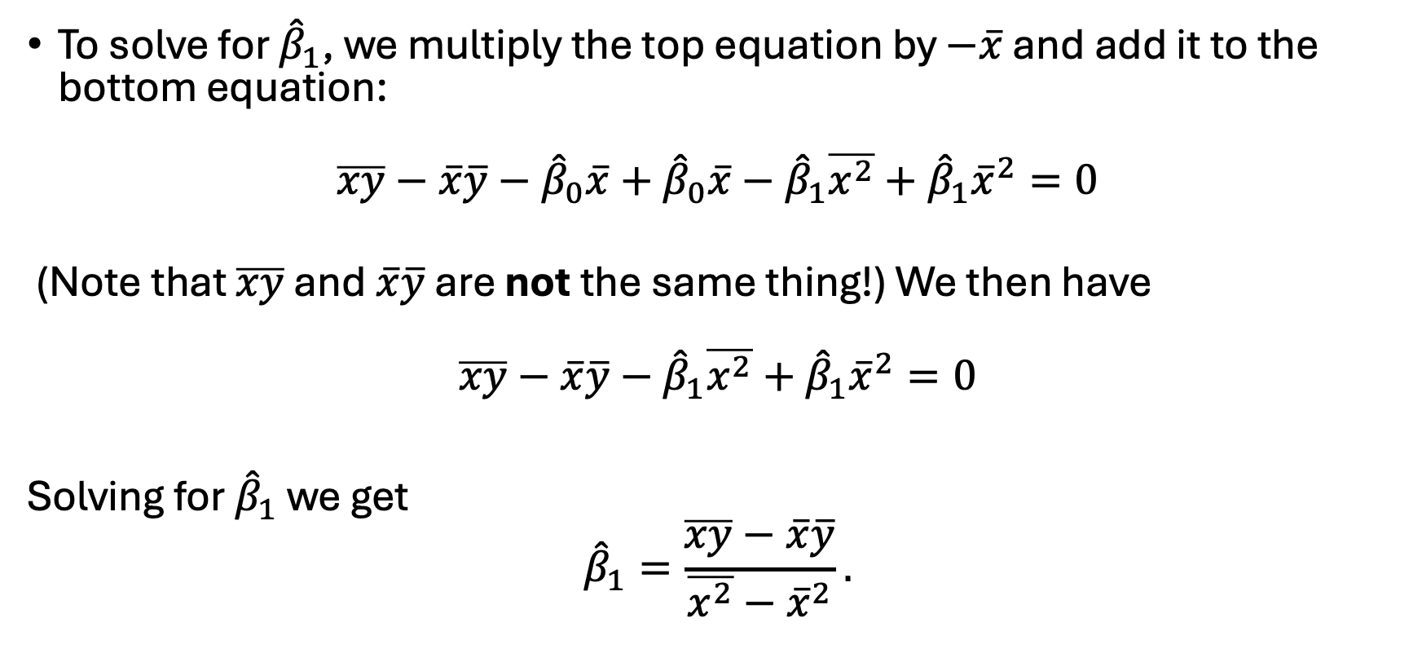
Calculating ${\hat{β}}_{0}$ and ${\hat{β}}_{1}$
To solve for ${\hat{β}}_{1}$, we multiply the top equation by $−\overline{x}$ and add it to the bottom equation:
$$\overline{xy}−\overline{x}\overline{y}−{\hat{β}}_{0}\overline{x}+{\hat{β}}_{0}\overline{x}−{\hat{β}}_{1}\overline{x^{2}}+{\hat{β}}_{1}{\overline{x}}^{2}=0$$
(Note that $\overline{xy}$ and $\overline{x}\overline{y}$ are not the same thing!) We then have
$$\overline{xy}−\overline{x}\overline{y}−{\hat{β}}_{1}\overline{x^{2}}+{\hat{β}}_{1}{\overline{x}}^{2}=0$$
Solving for ${\hat{β}}_{1}$ we get
$${\hat{β}}_{1}=\frac{\overline{xy}−\overline{x}\overline{y}}{\overline{x^{2}}−{\overline{x}}^{2}}.$$

Slide 19

Calculating ${\hat{β}}_{0}$ and ${\hat{β}}_{1}$
Similarly, from the original equation
$$\overline{y}−\left({\hat{β}}_{0}+β_{1}\overline{x}\right)=0$$
we solve for ${\hat{β}}_{0}$:
$${\hat{β}}_{0}=\overline{y}−β_{1}\overline{x.}$$

Slide 20
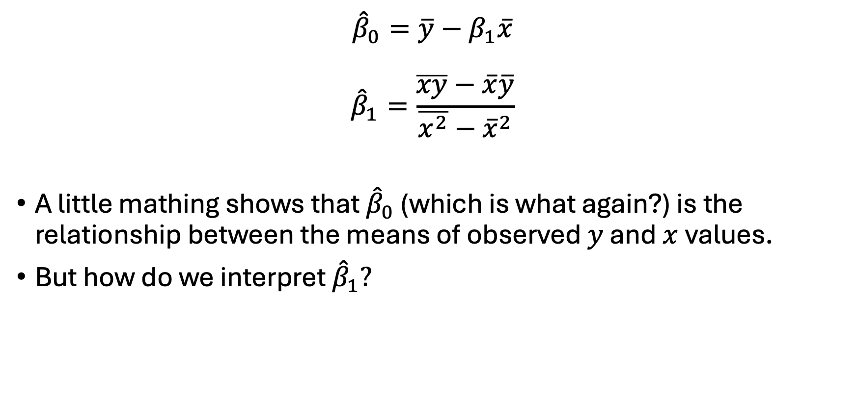
et Voilà.
$${\hat{β}}_{0}=\overline{y}−β_{1}\overline{x}$$
$${\hat{β}}_{1}=\frac{\overline{xy}−\overline{x}\overline{y}}{\overline{x^{2}}−{\overline{x}}^{2}}$$
A little mathing shows that ${\hat{β}}_{0}$ (which is what again?) is the relationship between the means of observed $y$ and $x$values.
But how do we interpret ${\hat{β}}_{1}?$

Slide 21
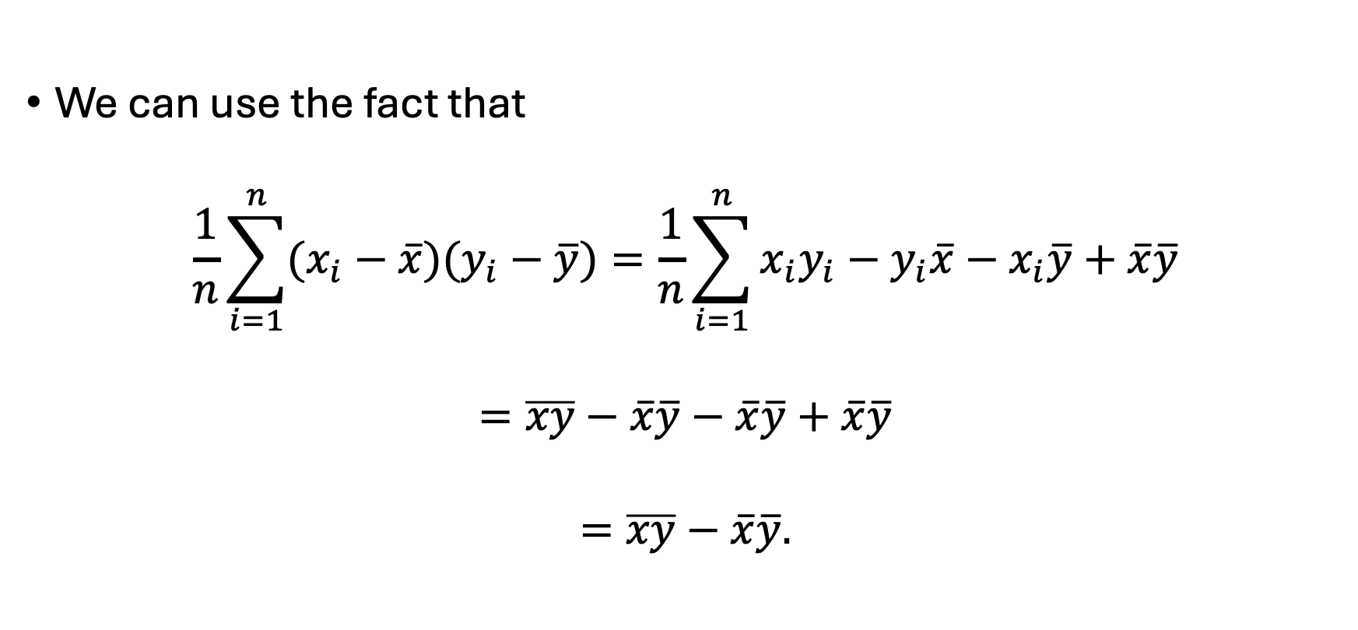
Some More Algebra
We can use the fact that
$$\frac{1}{n}\sum_{i=1}^{n}{(x_{i}−\overline{x})(y_{i}−\overline{y})}=\frac{1}{n}\sum_{i=1}^{n}{x_{i}y_{i}−y_{i}\overline{x}−x_{i}\overline{y}+\overline{x}\overline{y}}$$
$$=\overline{xy}−\overline{x}\overline{y}−\overline{x}\overline{y}+\overline{x}\overline{y}$$
$$=\overline{xy}−\overline{x}\overline{y}.$$

Slide 22
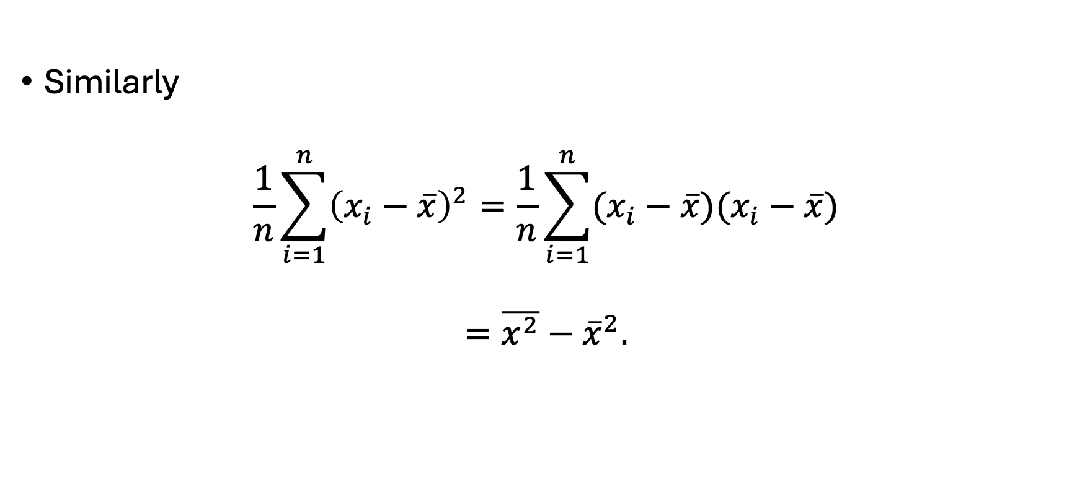
Some More Algebra
Similarly
$$\frac{1}{n}\sum_{i=1}^{n}{{\left(x_{i}−\overline{x}\right)}^{2}}=\frac{1}{n}\sum_{i=1}^{n}{(x_{i}−\overline{x})(x_{i}−\overline{x})}$$
$$=\overline{x^{2}}−{\overline{x}}^{2}.$$

Slide 23

Equivalences
Thus
$${\hat{β}}_{1}=\frac{\overline{xy}−\overline{x}\overline{y}}{\overline{x^{2}}−{\overline{x}}^{2}}$$
becomes
$${\hat{β}}_{1}=\frac{\frac{1}{n}\sum_{i=1}^{n}{(x_{i}−\overline{x})(y_{i}−\overline{y})}}{\frac{1}{n}\sum_{i=1}^{n}{{\left(x_{i}−\overline{x}\right)}^{2}}}$$

Slide 24
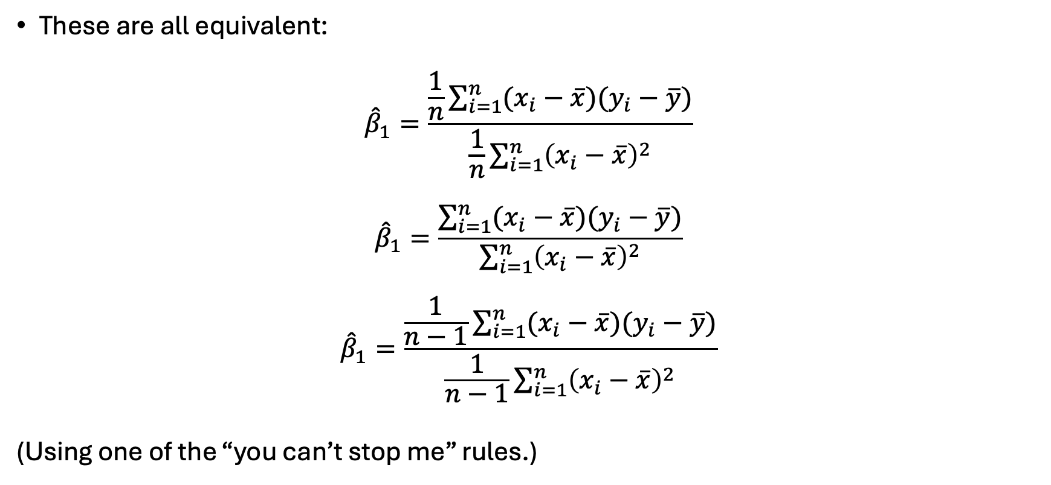
Equivalences
These are all equivalent:
$${\hat{β}}_{1}=\frac{\frac{1}{n}\sum_{i=1}^{n}{(x_{i}−\overline{x})(y_{i}−\overline{y})}}{\frac{1}{n}\sum_{i=1}^{n}{{\left(x_{i}−\overline{x}\right)}^{2}}}$$
$${\hat{β}}_{1}=\frac{\sum_{i=1}^{n}{(x_{i}−\overline{x})(y_{i}−\overline{y})}}{\sum_{i=1}^{n}{{\left(x_{i}−\overline{x}\right)}^{2}}}$$
$${\hat{β}}_{1}=\frac{\frac{1}{n−1}\sum_{i=1}^{n}{(x_{i}−\overline{x})(y_{i}−\overline{y})}}{\frac{1}{n−1}\sum_{i=1}^{n}{{\left(x_{i}−\overline{x}\right)}^{2}}}$$
(Using one of the “you can’t stop me” rules.)

Slide 25
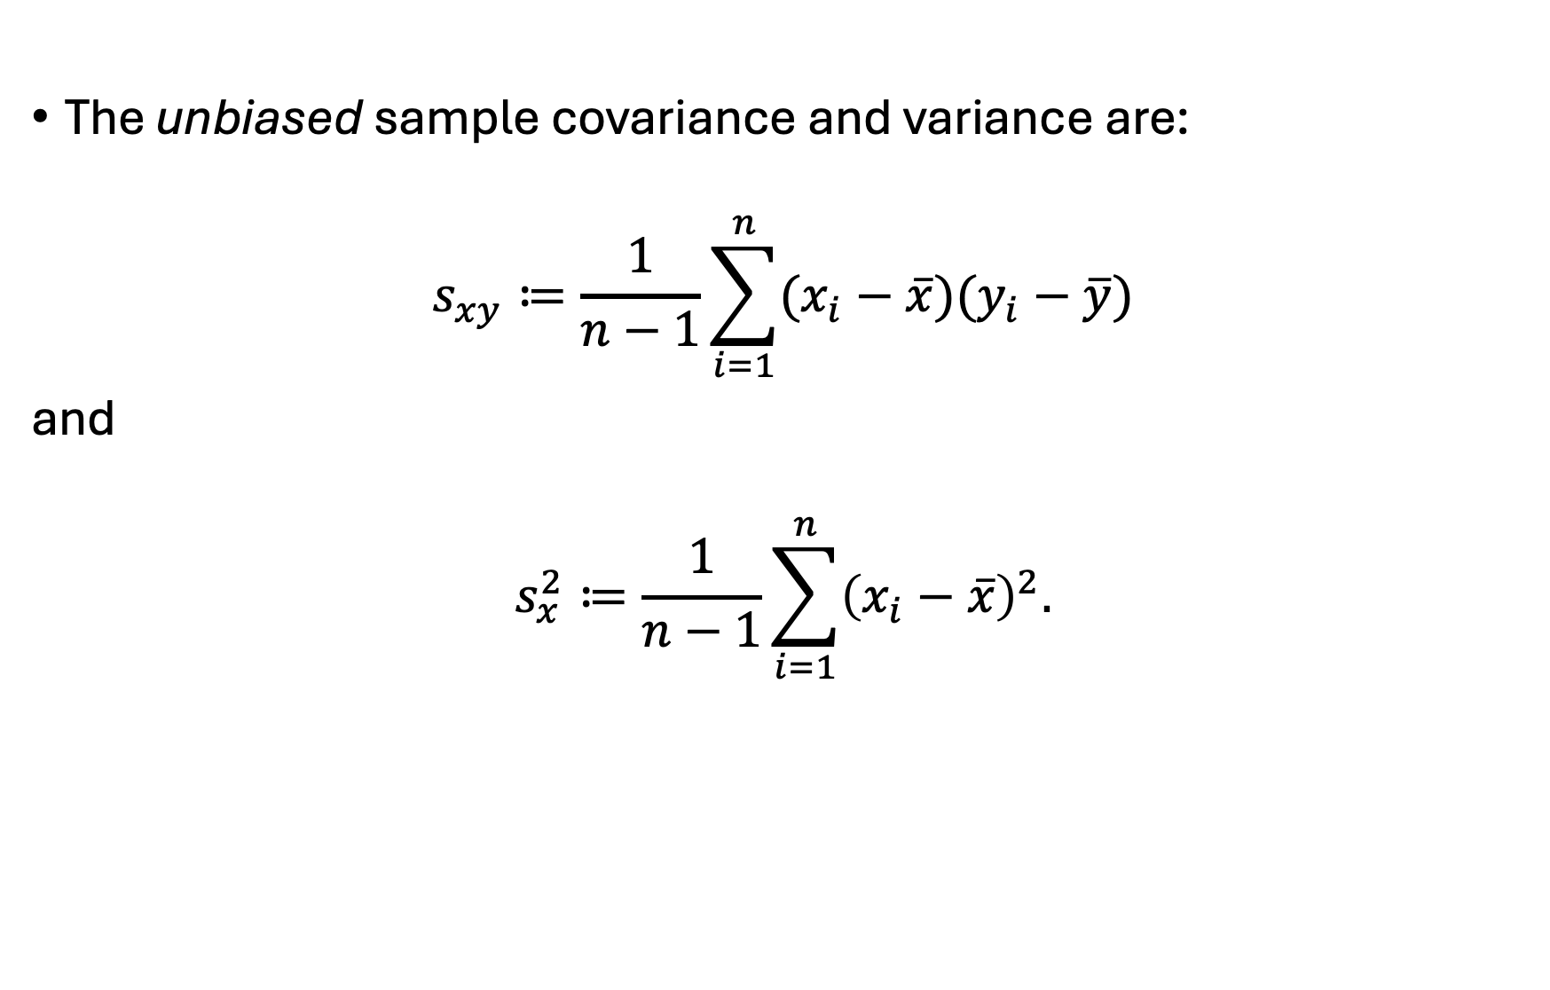
Recall from OA3102
The unbiased sample covariance and variance are:
$$s_{xy}≔\frac{1}{n−1}\sum_{i=1}^{n}{(x_{i}−\overline{x})(y_{i}−\overline{y})}$$
and
$$s_{x}^{2}≔\frac{1}{n−1}\sum_{i=1}^{n}{{\left(x_{i}−\overline{x}\right)}^{2}.}$$

Slide 26
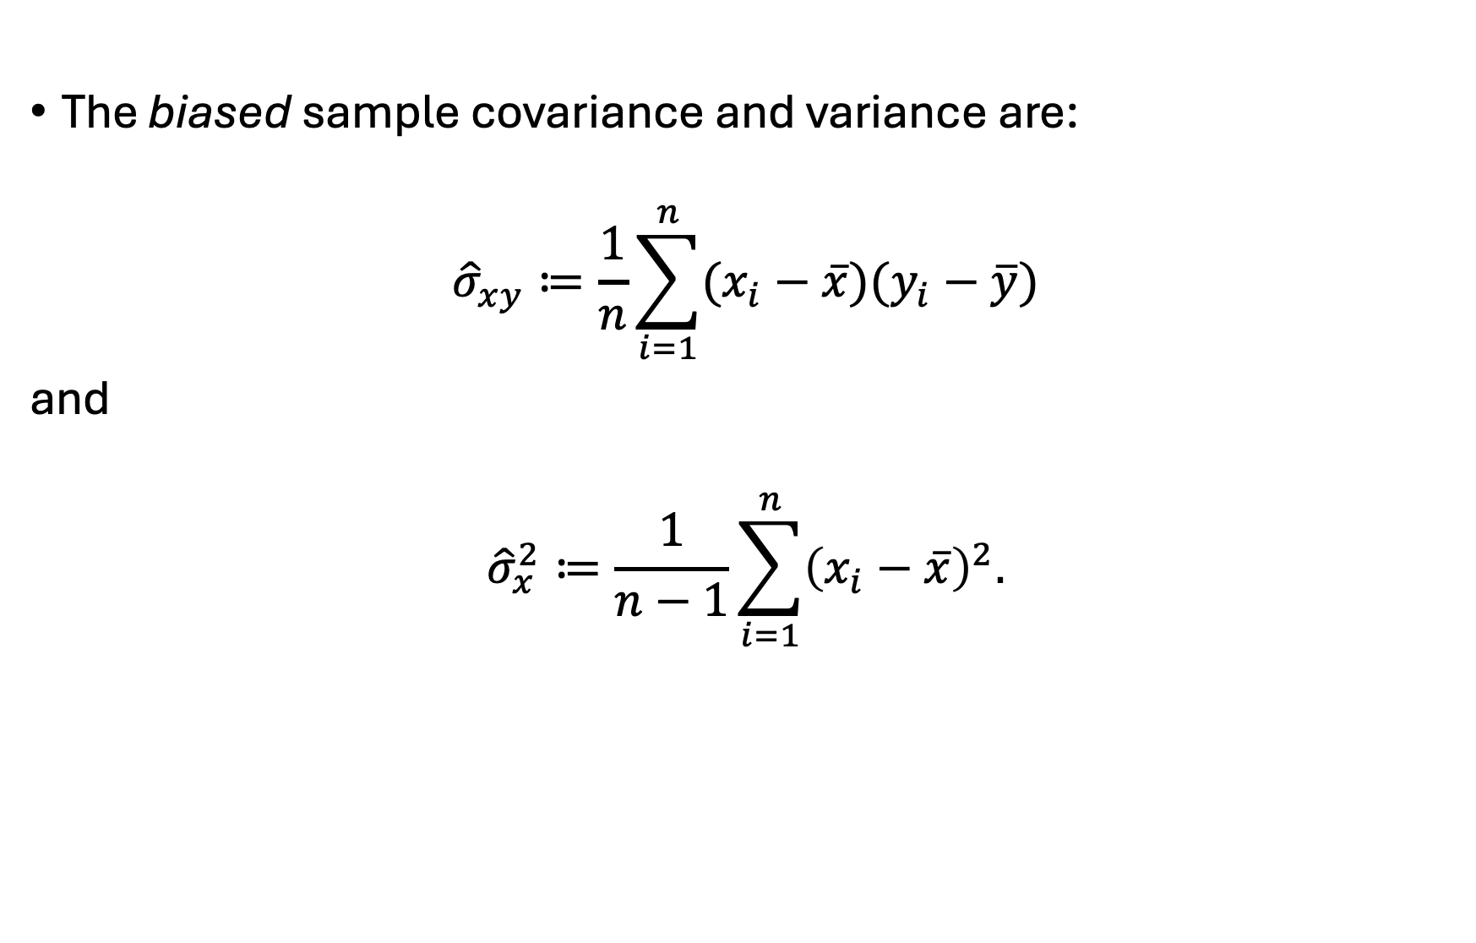
Recall from OA3102
The biased sample covariance and variance are:
$${\hat{σ}}_{xy}≔\frac{1}{n}\sum_{i=1}^{n}{(x_{i}−\overline{x})(y_{i}−\overline{y})}$$
and
$${\hat{σ}}_{x}^{2}≔\frac{1}{n−1}\sum_{i=1}^{n}{{\left(x_{i}−\overline{x}\right)}^{2}.}$$

Slide 27
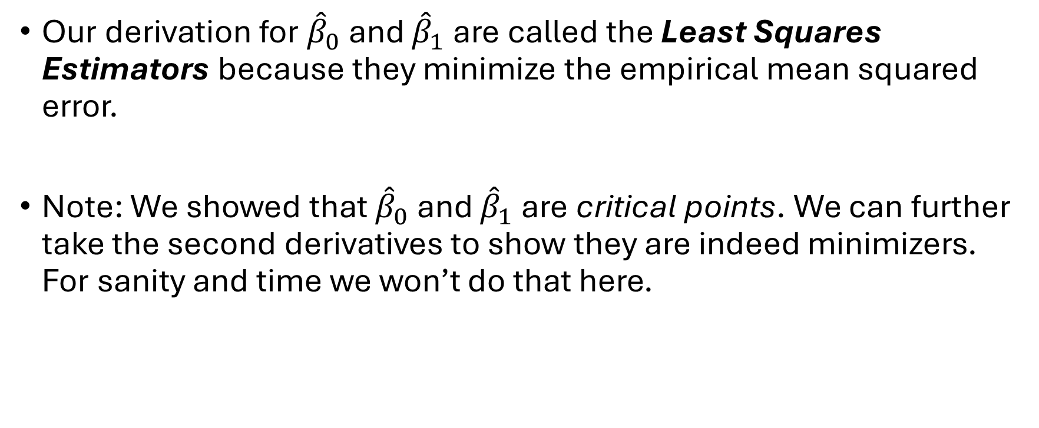
The Least Squares Estimators
Our derivation for ${\hat{β}}_{0}$ and ${\hat{β}}_{1}$ are called the Least Squares Estimators because they minimize the empirical mean squared error.
Note: We showed that ${\hat{β}}_{0}$ and ${\hat{β}}_{1}$ are critical points. We can further take the second derivatives to show they are indeed minimizers. For sanity and time we won’t do that here.

Slide 28

The Takeaways
We have shown that
$${\hat{β}}_{0}=\overline{y}−{\hat{β}}_{1}\overline{x}$$
which we can interpret as
Also:
$${\hat{β}}_{1}=\frac{{\hat{σ}}_{xy}}{{\hat{σ}}_{x}^{2}}=\frac{s_{xy}}{s_{x}^{2}}$$
which we can interpret as
Notes:
The slope is:
How much $y$changes, on average, for a one‑unit change in $x$.
And the formula
${\hat{β}}_{1}=\frac{s_{xy}}{s_{x}^{2}}$
tells us why:
The numerator $s_{xy}$measures how $x$and $y$move together.
The denominator $s_{x}^{2}$measures how much $x$varies on its own.
So the slope is:
The amount of co‑movement between $x$and $y$, scaled by how much $x$varies.
Also, the sign is dependent on the covariance.

Slide 29
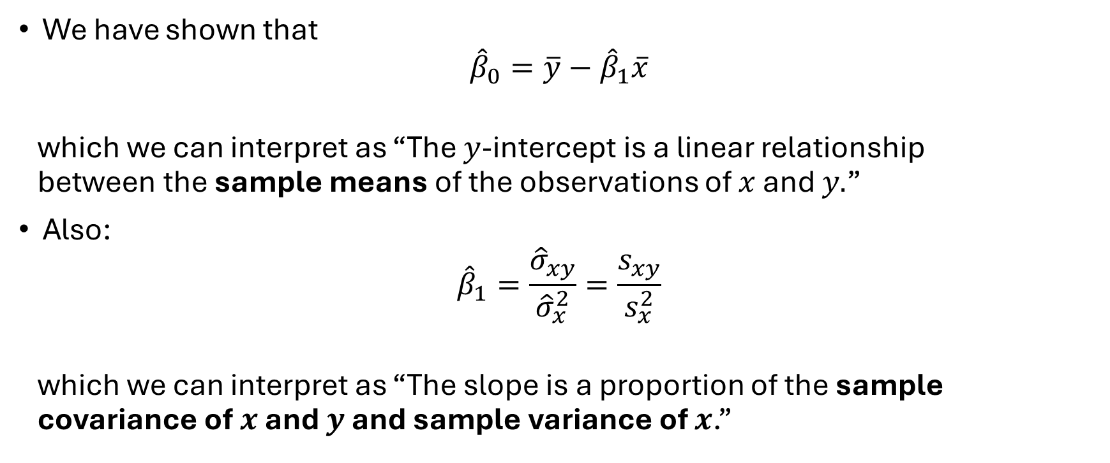
The Takeaways
We have shown that
$${\hat{β}}_{0}=\overline{y}−{\hat{β}}_{1}\overline{x}$$
which we can interpret as “The $y$-intercept is a linear relationship between the sample means of the observations of $x$ and $y.$”
Also:
$${\hat{β}}_{1}=\frac{{\hat{σ}}_{xy}}{{\hat{σ}}_{x}^{2}}=\frac{s_{xy}}{s_{x}^{2}}$$
which we can interpret as “The slope is a proportion of the sample covariance of $x$ and $y$ and sample variance of $x$.”
Notes:
The slope is:
How much $y$changes, on average, for a one‑unit change in $x$.
And the formula
${\hat{β}}_{1}=\frac{s_{xy}}{s_{x}^{2}}$
tells us why:
The numerator $s_{xy}$measures how $x$and $y$move together.
The denominator $s_{x}^{2}$measures how much $x$varies on its own.
So the slope is:
The amount of co‑movement between $x$and $y$, scaled by how much $x$varies.
Also, the sign is dependent on the covariance.

Slide 30
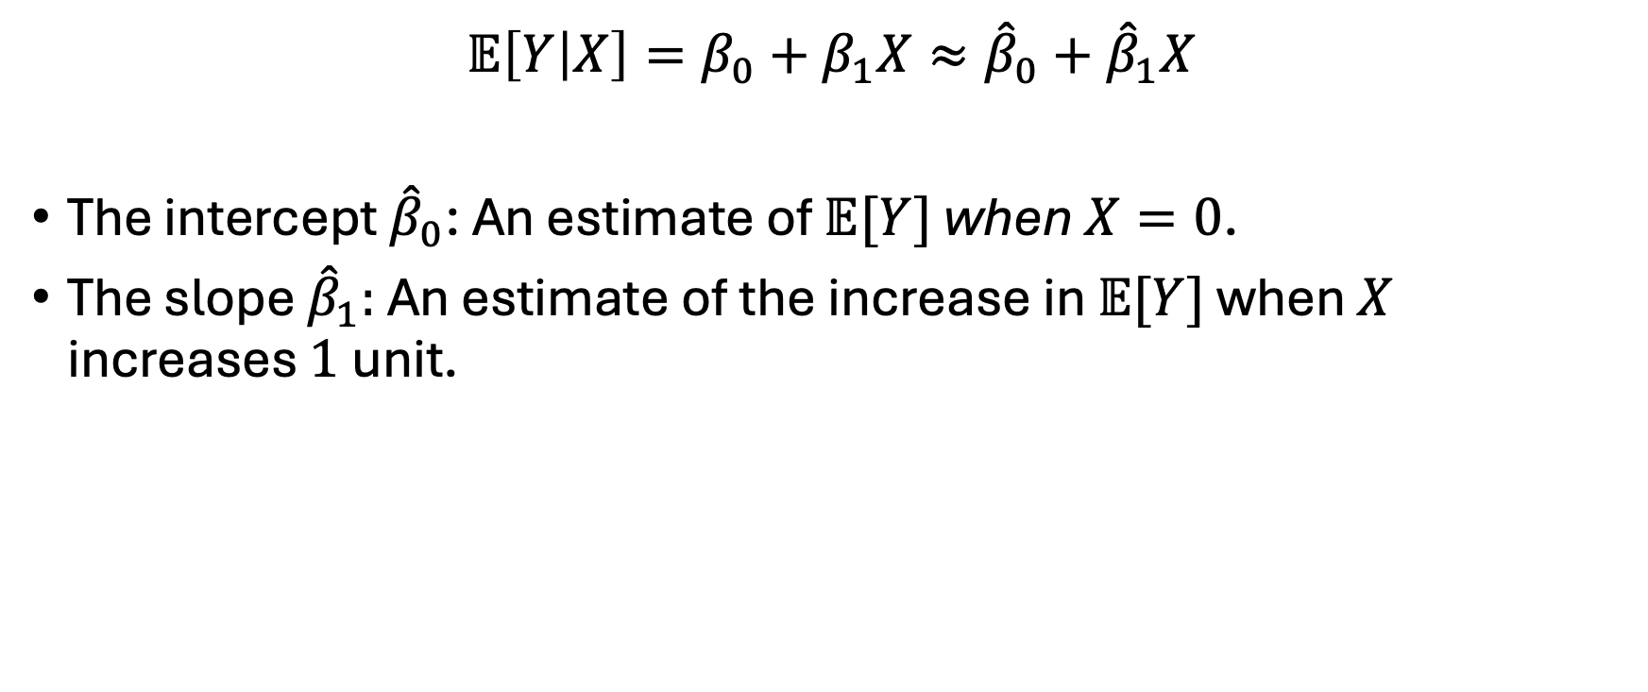
Interpretation
$$𝔼\left[Y | X\right]=β_{0}+β_{1}X≈{\hat{β}}_{0}+{\hat{β}}_{1}X$$
The intercept ${\hat{β}}_{0}$: An estimate of $𝔼[Y]$ when $X=0$.
The slope ${\hat{β}}_{1}:$ An estimate of the increase in $𝔼[Y]$ when $X$ increases $1$unit.

Slide 31
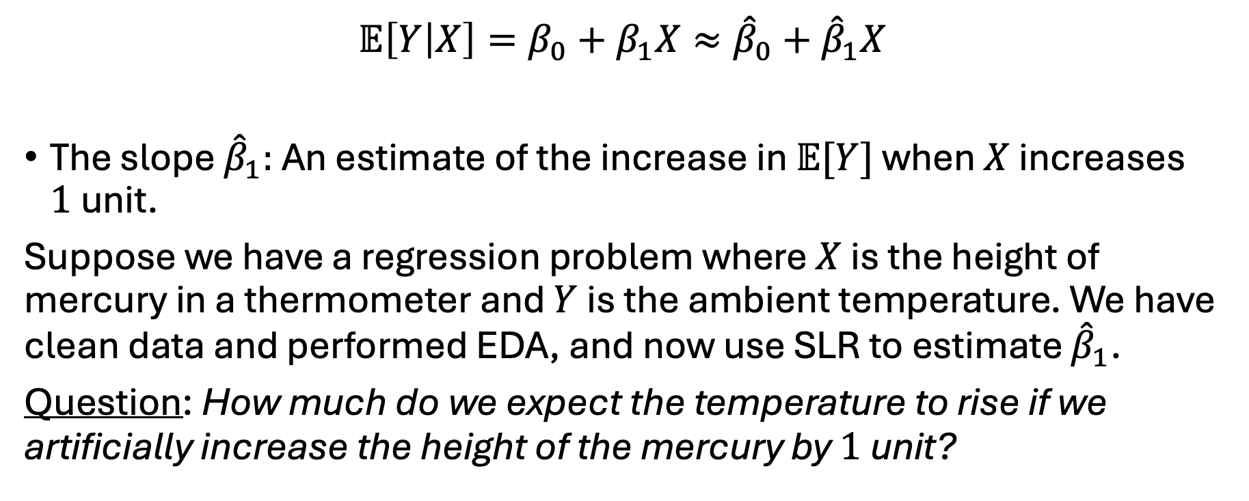
An Application
$$𝔼\left[Y | X\right]=β_{0}+β_{1}X≈{\hat{β}}_{0}+{\hat{β}}_{1}X$$
The slope ${\hat{β}}_{1}:$ An estimate of the increase in $𝔼[Y]$ when $X$ increases $1$unit.
Suppose we have a regression problem where $X$ is the height of mercury in a thermometer and $Y$ is the ambient temperature. We have clean data and performed EDA, and now use SLR to estimate ${\hat{β}}_{1}$.
Question: How much do we expect the temperature to rise if we artificially increase the height of the mercury by $1$unit?

Slide 32
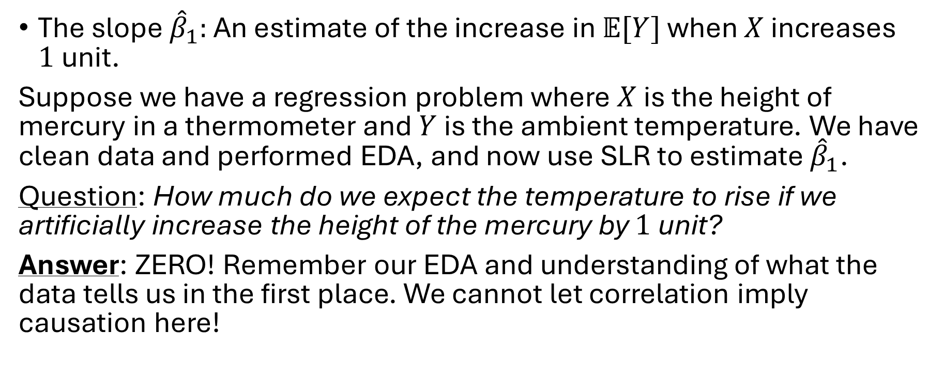
An Application
The slope ${\hat{β}}_{1}:$ An estimate of the increase in $𝔼[Y]$ when $X$ increases $1$unit.
Suppose we have a regression problem where $X$ is the height of mercury in a thermometer and $Y$ is the ambient temperature. We have clean data and performed EDA, and now use SLR to estimate ${\hat{β}}_{1}$.
Question: How much do we expect the temperature to rise if we artificially increase the height of the mercury by $1$unit?
Answer: ZERO! Remember our EDA and understanding of what the data tells us in the first place. We cannot let correlation imply causation here!

